Slide 1
Lead Scoring Case Study
By- Abdul , Marut , Virgil

Slide 2
Problem Statement
X Education sells online courses to industry professionals. X Education gets a lot of leads, its lead conversion rate is very poor. For example, if they acquire 100 leads in a day, only about 30 of them are converted.
To make this process more efficient, the company wishes to identify the most potential leads, also known as ‘Hot Leads’. If they successfully identify this set of leads, the lead conversion rate should go up as the sales team will now be focusing more on communicating with the potential leads rather than making calls to everyone.

Slide 3
Business Objective
The company requires us to build a model wherein you need to assign a
lead score to each of the leads such that the customers with higher lead
score have a higher conversion chance and the customers with lower
lead score have a lower conversion chance.
The CEO, in particular, has given a ballpark of the target lead conversion rate to be around 80%.

Slide 4
Solution or Approach
The approach followed throughout the lead scoring case study
Data Cleaning and Data Manipulation.
EDA
Feature Scaling & Dummy Variables and encoding of the data.
Classification technique: logistic regression used for the model making and prediction.
Validation of the model.
Model presentation.
Conclusions and recommendations.

Slide 5
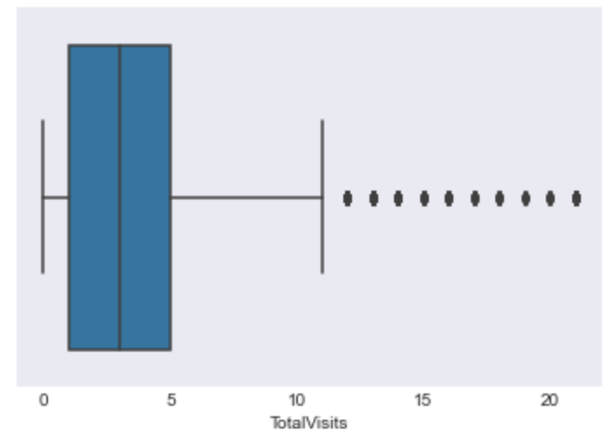
Boxplot after removing outliers (TotalVisits)

Slide 6
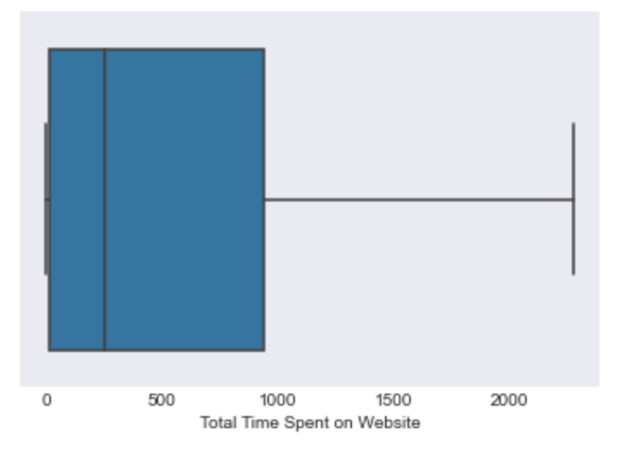
Analysis of Numerical Columns

Slide 7
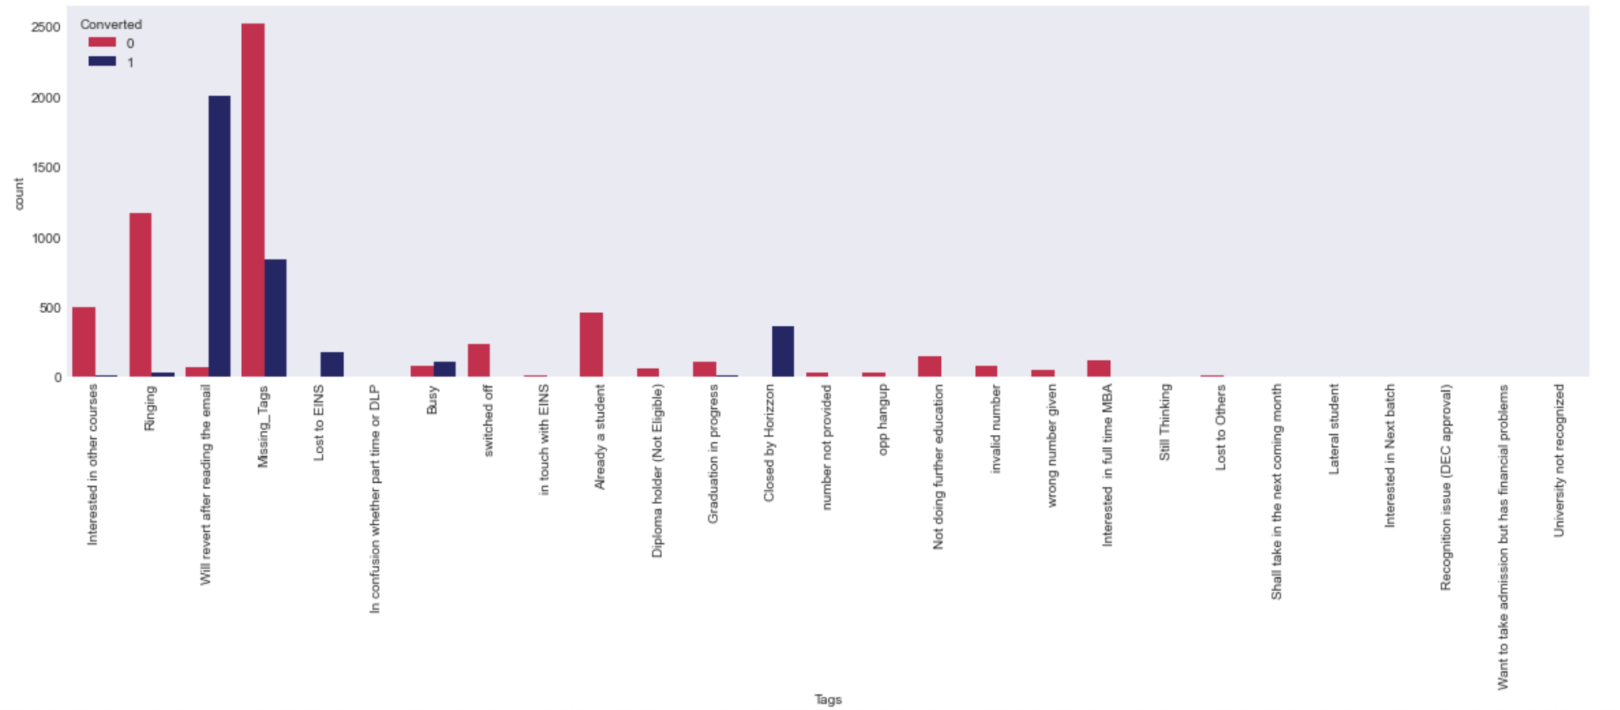
Bivariate Analysis of Categorical Columns

Slide 8
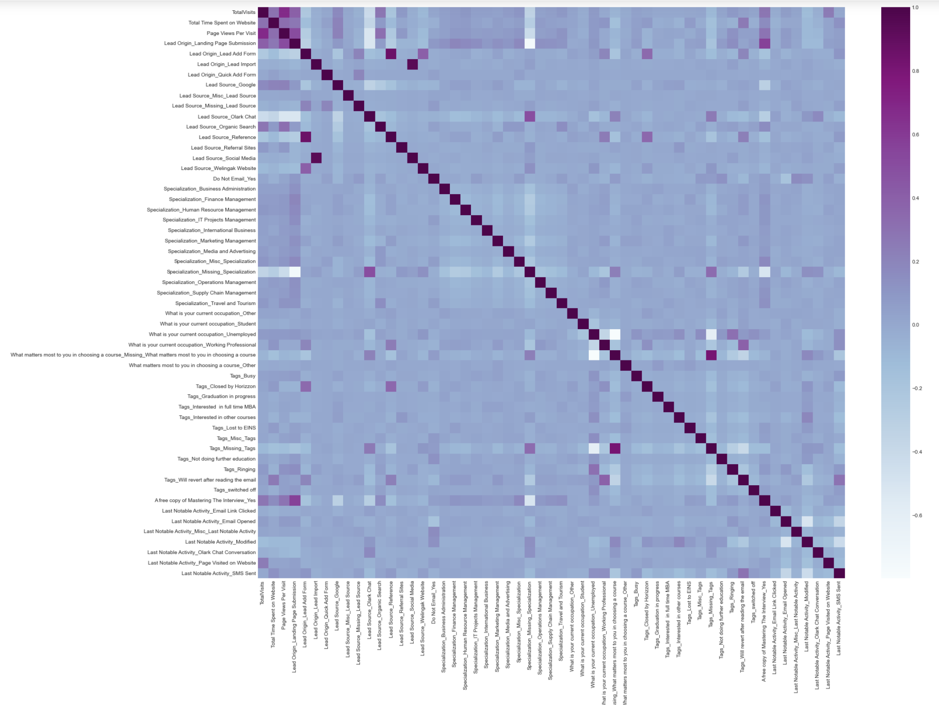
Heatmap

Slide 9
Model Building
Splitting the Data into Training and Testing Sets
The first basic step for regression is performing a train-test split, we have chosen 70:30 ratio.
Use RFE for Feature Selection
Running RFE with 15 variables as output
Building Model by removing the variable whose p-value is greater than 0.05 and VIF value is greater than 5
Predictions on test data set

Slide 10
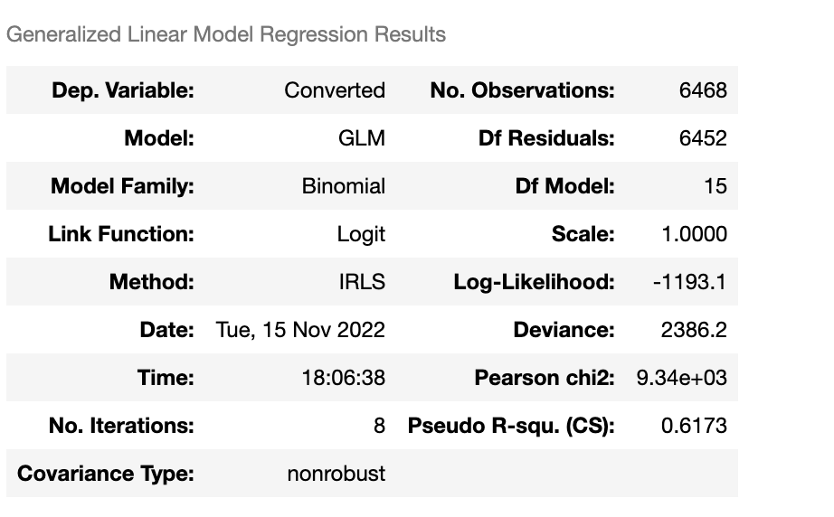
With the help of RFE, we can identify the insignificant variables present in our model.

Slide 11
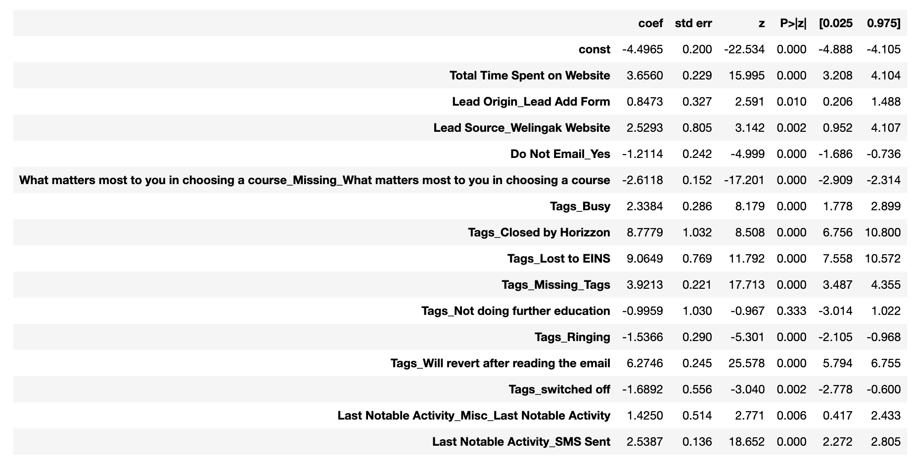

Slide 12
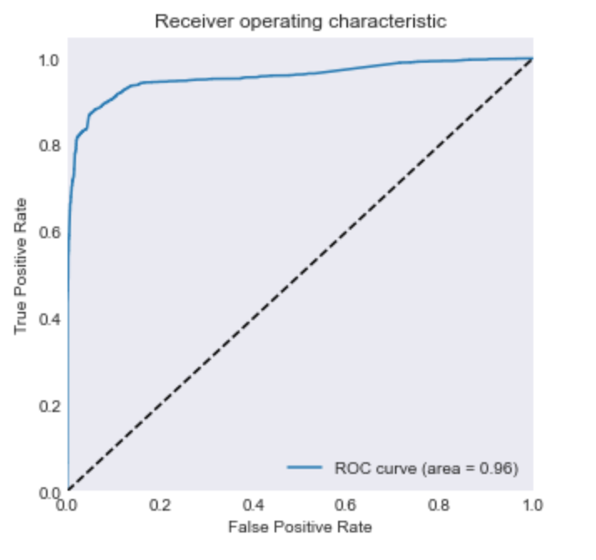
ROC Curve

Slide 13
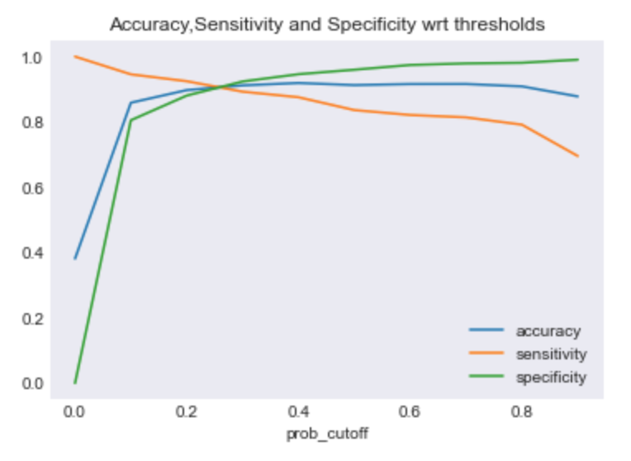
Finding Optimal Cut off Point
Optimal cut off probability is that probability where we get balanced sensitivity and specificity.
From the graph, the optimal cut off point is visible now

Slide 14
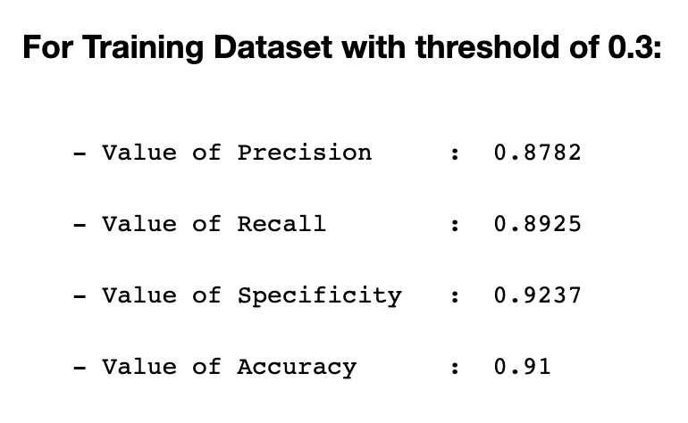
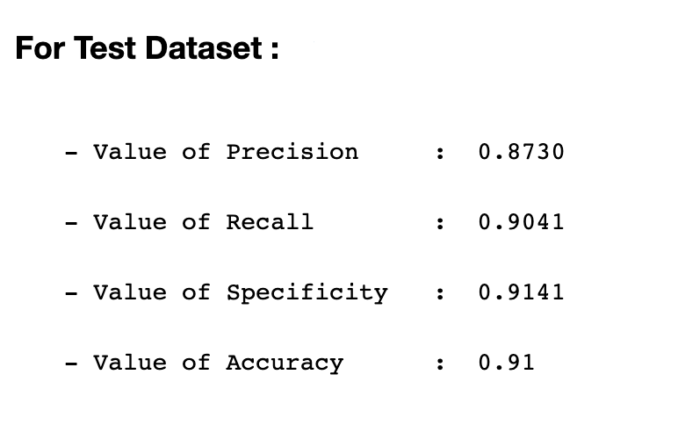
For Training Dataset and Test Dataset

Slide 15
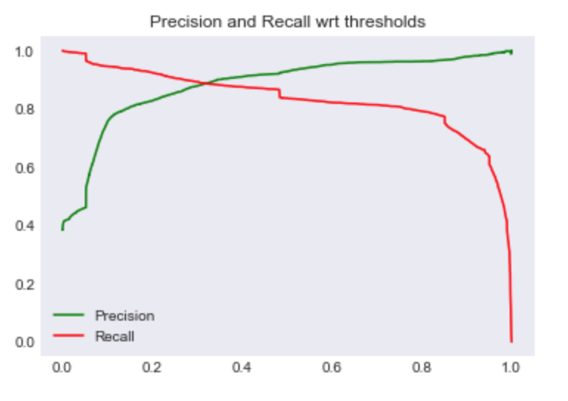
Precision-Recall Curve

Slide 16
Conclusion
It was found that the variables that mattered the most in the potential buyers are (in descending order) :
1. Tags_Closed by Horizzon
2. Tags_Lost to EINS
3. Tags_Will revert after reading the email
4. Lead Source_Welingak Website
5. Tags_switched off
6. Total Time Spent on Website

